Slide 1

Olist Business Analysis: Uncovering Opportunities for Growth and Optimization
Team Carrot
Iris Cheung
Bill Chan
Karl Kwan
Lisha Liao

Slide 2


Olist: Brazilian
Founded in 2015.
One of the businesses
E-commerce solutions for small and medium-sized businesses
Focused on operational management

Slide 3

Olist's Dataset
2016.09-2018.09
Order
Order item
Product
Customer
Payment
Geolocation of Brazil

Slide 4

Olist's Platform Performance Metrics
Lisha:
Numbers of customers, sellers and orders
Revenue
Cancelled order rate
Proportion of valuable customers(RFM Model)
Iris:
Repurchase Rate
Bill:
Customer Satisfaction (Product Ratings and Reviews)
Karl:
Average Handling Time
Delivery Performance

Slide 5

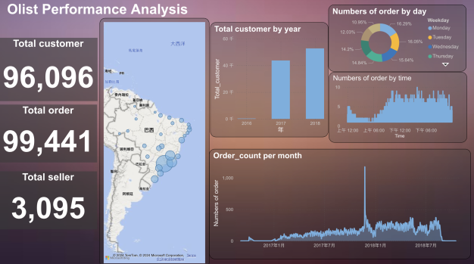

Slide 6
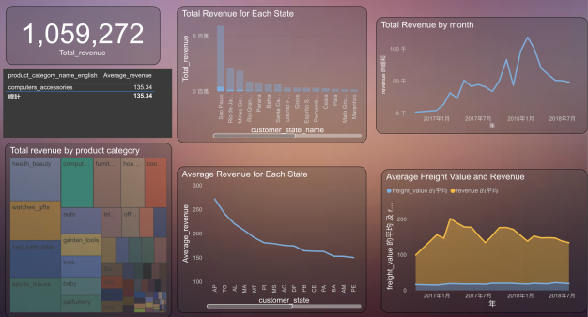

Slide 7
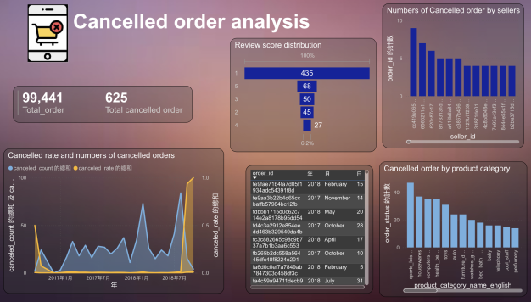

Slide 8
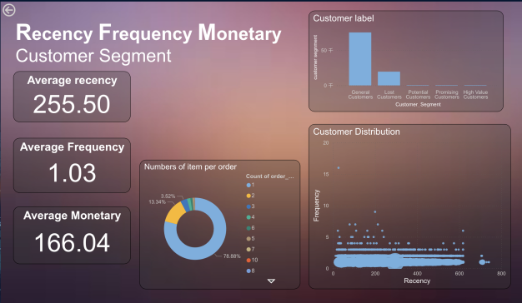

Slide 9
Customer
High Value Customers
R < 90
F > 5
M > 1000
Potential Customers
R < 180
F 2 to 5
M 300 to 1000
Promising Customers
R < 120
F >= 3
M >= 600
General Customers
R < 365
F 1 to 5
M 100 to 600
Lost Customers
R > 365
F = 1
M < 100

Slide 10
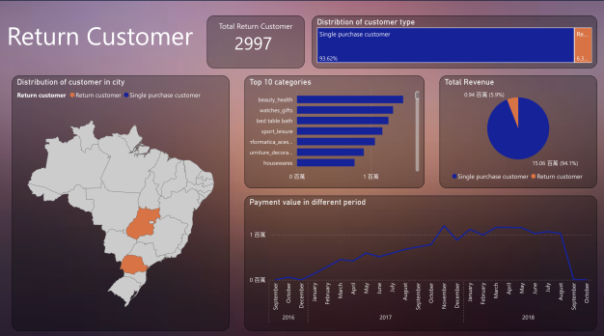
Notes:
以下是巴西一些按月份举行的重要节日：
一月：
新年（Ano Novo）：1月1日，庆祝新年的到来，人们会参加烟火表演和庆祝活动。
二月／三月：
卡纳瓦尔（Carnaval）：复活节前的四十天内举行，日期会根据复活节的日期而有所变化。巴西最大的狂欢节，包括狂欢游行、音乐和舞蹈。
六月：
圣约翰节（Festa de São João）：6月24日，庆祝圣约翰洗礼日，人们会举行篝火晚会、跳舞、烟火和传统食物的盛宴。
十月：
儿童节（Dia das Crianças）：10月12日，庆祝儿童，人们会给孩子们送礼物、举办儿童活动和游戏。
十一月：
死者节（Dia de Finados）：11月2日，纪念已故亲人的节日，人们会前往墓地祭拜和献花。
十二月：
圣诞节（Natal）：12月25日，庆祝耶稣基督的诞辰，人们会举行宗教仪式、家庭聚会和交换礼物。

Slide 11
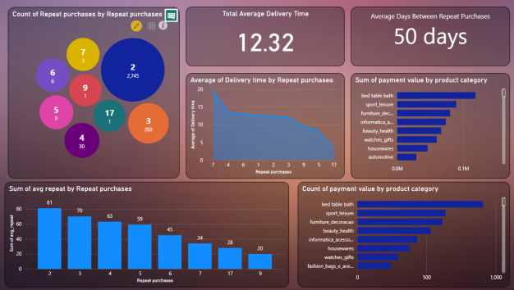

Slide 12
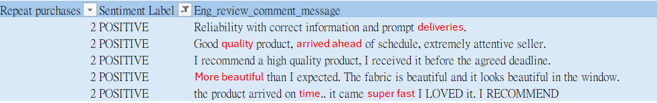
Return Customer Review Overview

Slide 13



Positive and Negative feedback
Negative feedback can help companies identify problems and make improvements
Enhance the company's brand image and market influence
Enhance customer satisfaction

Slide 14
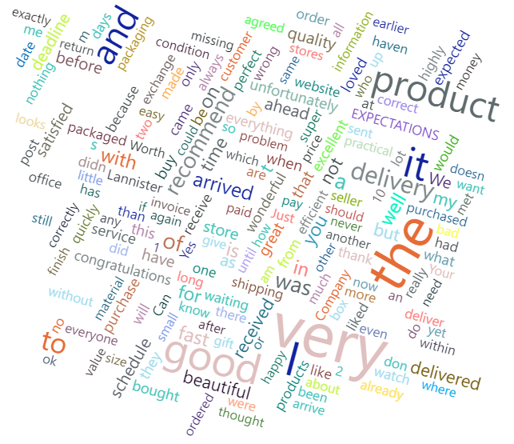

Positive and Negative machine learning
openai/whisper-large-v3

Slide 15
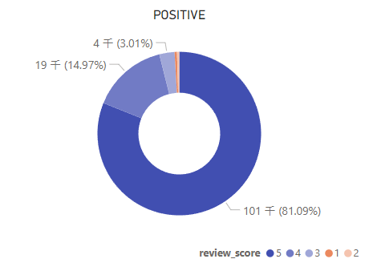
1 Start but positive comments

Slide 16
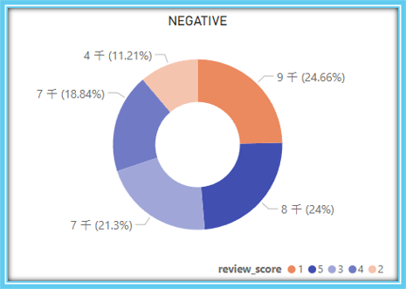
5 Start but negative comments

Slide 17
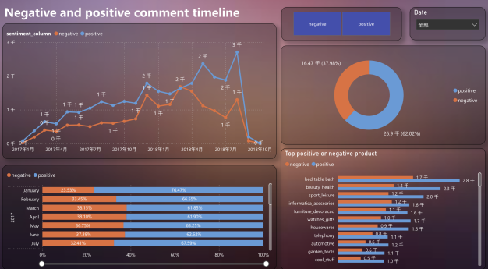

Slide 18
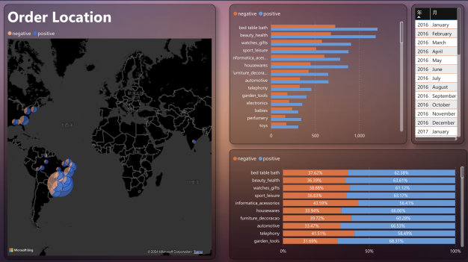

Slide 19
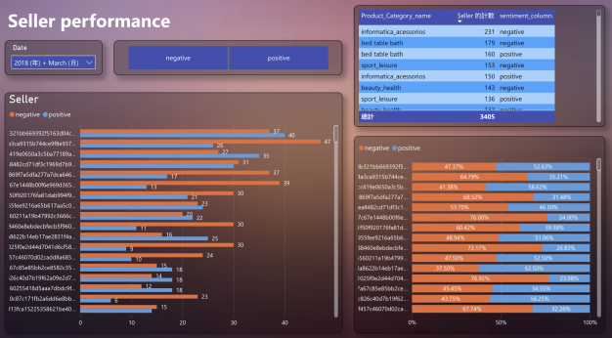

Slide 20
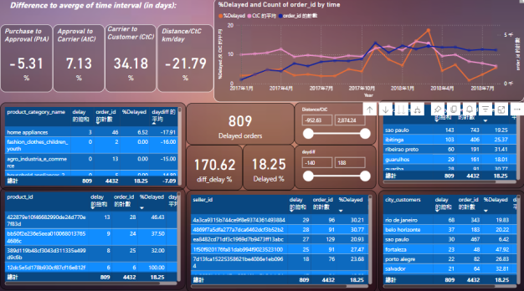

Slide 21
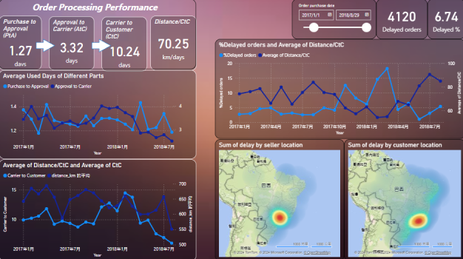

Slide 22
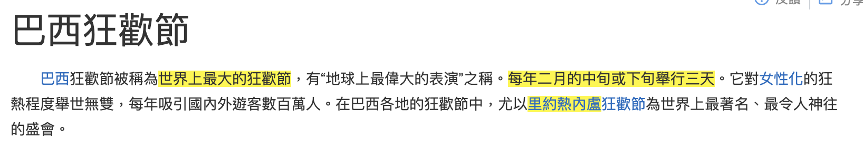
Order Processing Performancce
Overview and in-depth pages
Functions:
1. monitoring performance
2. try to pinpoint which specific part of the process is causing the delay issue
Delay problem may affected by:
Specific days > geolocation > product category > seller

Slide 23
Technique

Slide 24
Distances from the 2 points (customer&selle) based on lat/lon
What we get from dataset:
Timestamps and 2 coordinates
We want to transfer it into distance/time, to better compare the performance.
from geopy.distance import geodesic
distance_km = geodesic(point1, point2).km
GeoPy: a Python library that performs geographical calculations
Geodesic: a module return the length of shortest path between 2 points

Slide 25

Python VS Google Sheet
Order_review.csv: 100 thousand rows
- Import libray: GoogleTranslator
Require high technique
Python Coding
Slow
12 hours finish translation
Translate in google Sheet
Require low technique
= googletranslate(value,"pt","en")
Quick
27 mins finish translation (Eng)
1:19 hours finish translation (Chi)
1.5 mins finish translation 100 thousand words
Notes:
將複雜事簡單化是社會 trend simplfy, increase productivity

Slide 26
Google Sheet Quality
review_comment_message | review_comment_message | 評論_評論_訊息 | huggingface_facebook
Recebi bem antes do prazo estipulado. | I received it well before the stipulated deadline. | 我在規定的截止日期之前收到了它。
aparelho eficiente. no site a marca do aparelho esta impresso como 3desinfector e ao chegar esta com outro nome...atualizar com a marca correta uma vez que Ã© o mesmo aparelho | efficient device. On the website the brand of the device is printed as 3desinfector and when it arrives it has a different name... update with the correct brand as it is the same device | 高效能的設備。在網站上，設備的品牌印為 3desinfector，當它到達時，它有一個不同的名稱...更新為正確的品牌，因為它是同一台設備 | efficient device. On the website the device's mark is printed as 3desinfectant and when you arrive it's under another name... update with the correct mark once it's the same device
Mas um pouco ,travando...pelo valor ta Boa. | But a little slow...for the price, it's good. | 不過有點慢……以這個價格來說，已經不錯了。
Sempre compro pela Internet e a entrega ocorre antes do prazo combinado, que acredito ser o prazo mÃ¡ximo. No stark o prazo mÃ¡ximo jÃ¡ se esgotou e ainda nÃ£o recebi o produto. | I always buy online and delivery occurs before the agreed deadline, which I believe is the maximum deadline. At Stark, the maximum deadline has already passed and I still haven't received the product. | 我總是在網上購買，交貨發生在約定的截止日期之前，我認為這是最長的截止日期。在史塔克，最大期限已經過去了，我仍然沒有收到產品。 | I always shop online and delivery is before the agreed deadline, which I believe is the maximum deadline.

Slide 27
Google Sheet limitation?
Size: 10,000,000 cells
--> 1 column: 10,000,000 rows
--> Actually 26 columns:
(10,000,000 cells / 26 columns = 384,615.4 rows)

Slide 28
Summary
Problem Statement
Improvement Recommendations
Future Outlook
Notes:
分工
困難: 如何解決

Slide 29
Team Cooperation

Slide 30

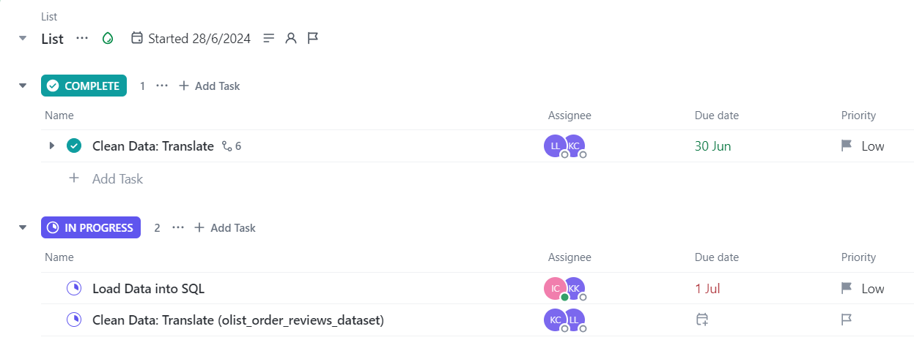

Division of work

Slide 31

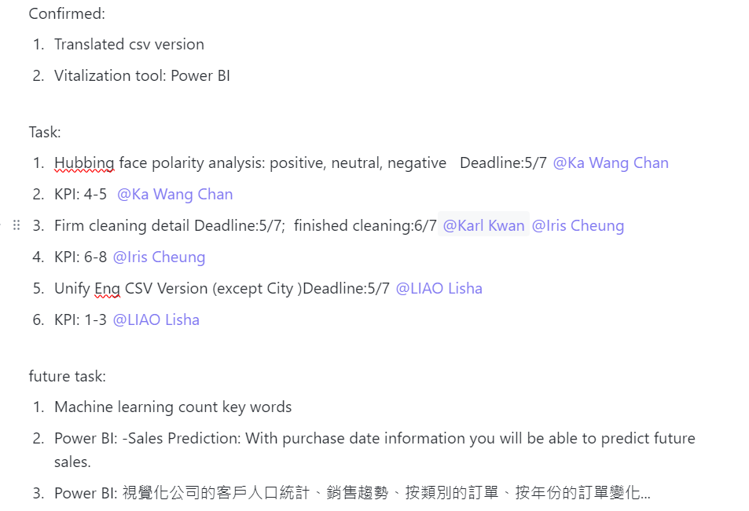
Notes:
最初形開會

Slide 32
Overview of Difficulties & Solution
Notes:
Technique: python 計複雜的數 to power BI code, 2個language, ; 人事上困難, 私人事務要做, 未必可以全程投入, 靠set deadline , 見到成果, 接下來到Q&A

Slide 33
Q&A

